Slide 1
БакЛекция 10_2024: Иерархический кластер-анализ. Агломеративные и дивизивные методы.
Кластерная иерархия:
Корневое бинарное дерево (часто снабженное высотной функцией) с листьями, помеченными объектами

Slide 2
Основные понятия лекции 9: Бутстрэп
Бутстрэп – порождение произвольного количества датасетов путем случайной выборки того же количества объектов с возвращением.
Вероятность непопадания объекта в выборку с возвращением (1/е).
Валидация центра – путем формирования интервала, содержащего 95% средних по выборкам бутстрэпа
Сравнение центров – путем вычисления разностей в каждой выборке бутстрэпа с последующей 95% валидацией на распределении разностей
Бутстрэп с опорой – в предположении, что распределение интересующей величины нормально, и без опоры – путем изъятия 2.5% интервалов распределения слева и справа

Slide 3
Содержание
Кластерная иерархия: бинарное корневое дерево, снабженное высотной функцией
Алгоритмы построения кластерных иерархий
Агломеративные (Agglomerative)
Дивизивные (Divisive)
Два способа измерения расстояний между кластерами:
Расстояние Уарда (Ward)
Расстояние ближнего соседа (Nearest Neighbor)
Расстояние Уарда как прирост критерия метода К-средних при объединении кластеров
Критерий ближнего соседа в агломеративном кластеринге
Максимальный (минимальный) остов (Max/Min Spanning Tree): алгоритма Прима
Дивизивный кластер-анализ на основе MST

Slide 4
Cluster Hierarchy: Binary rooted tree
Over data set as the leaf set
Interior nodes: clusters of leaves; say F={AV,AN,AS}
Height function defined at all nodes
h(leaf)=0,
if t ⊂ s, then h(t)<h(s)
F G H
AV AN AS BA BR BU CI CY

Slide 5
Two types of algorithms: agglomerative (bottom-up) divisive (up-down)

Slide 6
Two popular criteria (out of many others): Square error Nearest Neighbor NN

Slide 7
Agglomerative clustering, 1/Агломеративный
Step 1: Start –
- Trivial partition of the set of objects represented by their indices in N singletons: S={{1}, {2}, …, {i}, …, {N}}
- (Dis)similarity function D=(d(i,j)), i,j= 1, 2,…, N
(either distances or similarities from the object-to-feature data, or raw network interaction data)

Slide 8
Agglomerative clustering, 2
General step: given partition S ={S1, S2,…, Sm} and between-cluster dis(similarity) function d(s,t) (s,t=1,…, m),
G1: Find s*, t* minimizing dissimilarity d(s,t) (maximizing similarity) – a costly operation
G2: Merge clusters Ss* and St* to form Ss*t*=Ss* ∪ St*
G3: Compute (dis)similarity between Ss*t* and every other cluster Su to form a new (dis)similarity matrix
G4: Define and compute value of height h(Ss*t*)
Test: Stopping condition. If Yes, stop; output the hierarchy. If not, m:= m-1 and go to G1.

Slide 9
Agglomerative clustering, 3
Different AgglClus Algorithms differ by only this:
G3: Compute (dis)similarity between Ss*t* and every other cluster Su to form a new (dis)similarity matrix
Two most popular:
Nearest neighbor (according to dis(similarity) between the nearest points from clusters)
Ward algorithm (according to change in the square error criterion)
In both agglomerative and divisive versions

Slide 10
Divisive clustering: building cluster hierarchy up-down
Step 1: given an entity subset Sk and a dis(similarity) function d(i,j) (i,j∈Sk),
G1: Divide Sk in two non-empty parts Sk1 and Sk2 according to an algorithm/criterion.
G2: Remove Sk from the hierarchy leaf-set and add parts Sk1 and Sk2 to the leaf-set.
G3: If needed, compute the heights of Sk1 and Sk2.
Step 2: Determine a leaf-set as Sk for the next division. If Sk=∅ (empty), Stop.
Step 3: Test whether (a) Sk should be further divided or (b) Sk’s homogeneity suffices. If (a), go to Step 1. If (b), go to Step 2.

Slide 11
Ward algorithm, both divisive and agglomerative, based on the so-called Ward distance
Nearest neighbor divisive algorithm,
based on Minimum (Maximum) Spanning
Tree (MST)

Slide 12
Ward distance between clusters S_{k} and S_{l} (to be derived further on)
This combines distance between cluster centers c_{k}, c_{l} and a factor depending on the distribution of objects between the clusters:
the smaller the difference in sizes N_{k} and N_{l}, the larger the value of the factor.

Slide 13
Ward distance between clusters S_{k} and S_{l} (to be derived further on)
At Ward divisive clustering, a cluster is split in two parts maximizing wd.
At Ward agglomerative clustering, two clusters are merged to minimize wd.
In both cases, a balanced partition is preferred by the criterion.

Slide 14
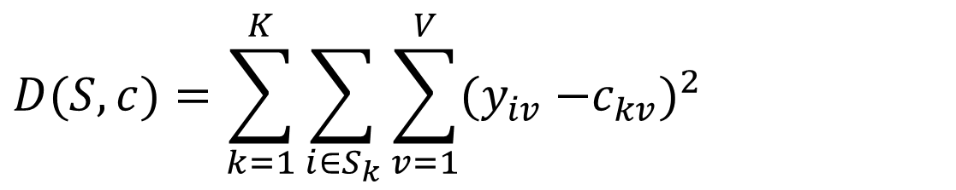
Ward distance is the difference between K-means criterion values before and after merging clusters
$$D(S,c)=\sum_{k=1}^{K}{\sum_{i∈S_{k}}{\sum_{v=1}^{V}{(y_{iv}\text{ −}c_{kv})^{2}}}}$$
Wd(S_{k},S_{l}) = D(S(k,l), c^{kl}) – D(S, c) =

Slide 15
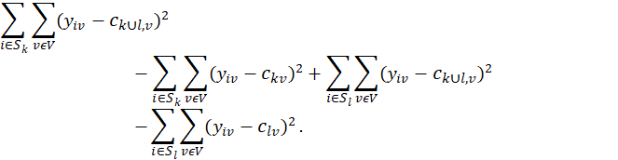
Derivation of Ward distance, 1:
Wd(S_{k},S_{l}) = D(S(k,l), c^{kl}) – D(S, c) =

Slide 16
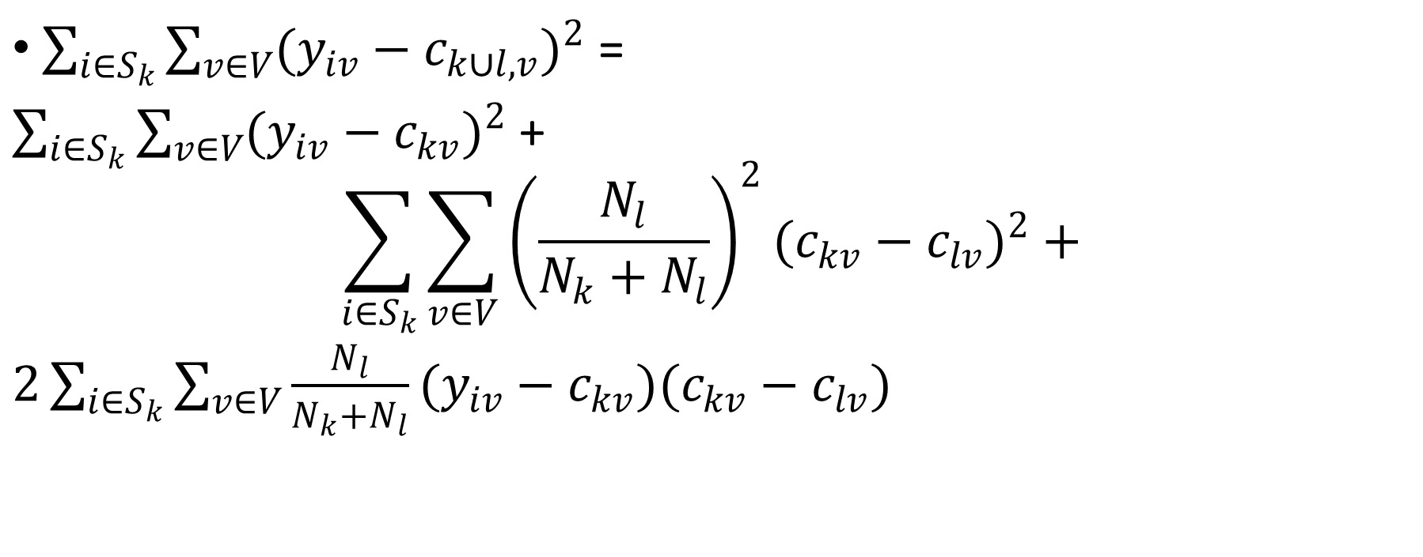
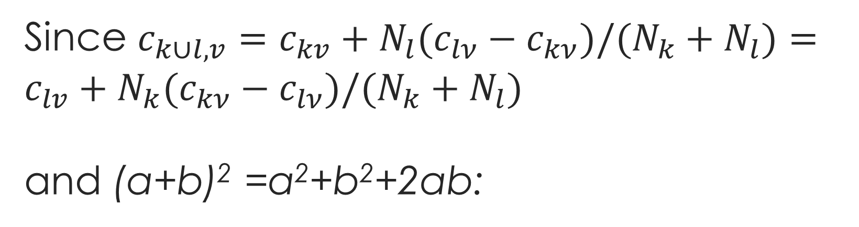
Since $c_{k∪l,v}=c_{kv}+N_{l}(c_{lν}−c_{kν})/(N_{k}+N_{l})=c_{lv}+N_{k}(c_{kν}−c_{lν})/(N_{k}+N_{l})$ and (a+b)² =a²+b²+2ab:
$\sum_{i∈S_{k}}{\sum_{v∈V}{(y_{iv}−c_{k∪l,v})^{2}}}$ =
$\sum_{i∈S_{k}}{\sum_{v∈V}{(y_{iv}−c_{kv})^{2}} }$+
$$\sum_{i∈S_{k}}{\sum_{v∈V}{{\left(\frac{N_{l}}{N_{k}+N_{l}}\right)}^{2}(c_{kv}−c_{lv})^{2}+}}$$
$2\sum_{i∈S_{k}}{\sum_{v∈V}{\frac{N_{l}}{N_{k}+N_{l}}(y_{iv}−c_{kv})(c_{kv}−c_{lv})}}$

Slide 17
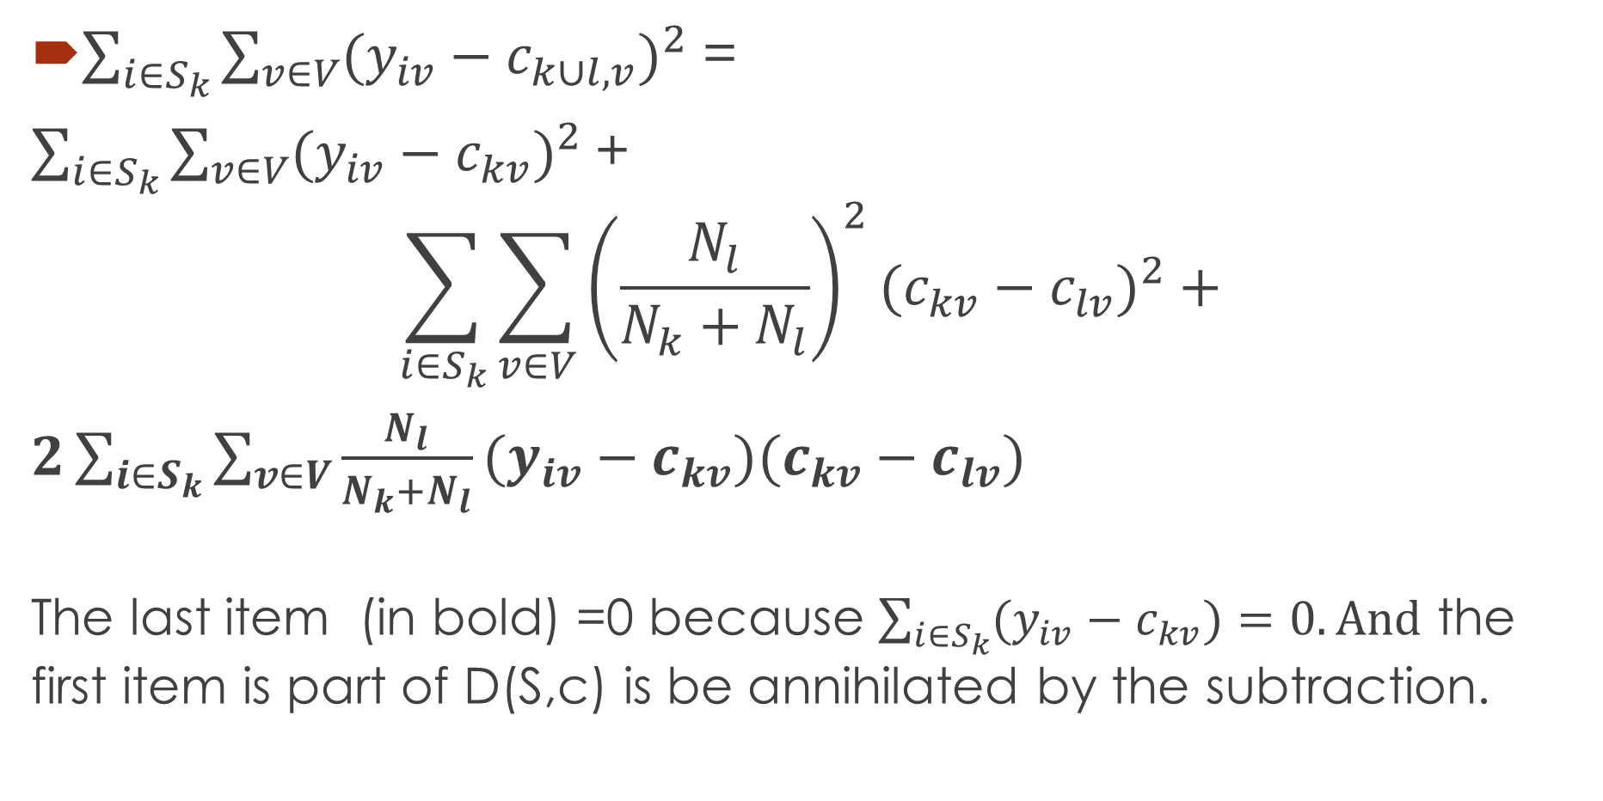
As proven above,
$\sum_{i∈S_{k}}{\sum_{v∈V}{(y_{iv}−c_{k∪l,v})^{2}}}$ =
$\sum_{i∈S_{k}}{\sum_{v∈V}{(y_{iv}−c_{kv})^{2}} }$+
$$\sum_{i∈S_{k}}{\sum_{v∈V}{{\left(\frac{N_{l}}{N_{k}+N_{l}}\right)}^{2}(c_{kv}−c_{lv})^{2}+}}$$
$2\sum_{i∈S_{k}}{\sum_{v∈V}{\frac{N_{l}}{N_{k}+N_{l}}(y_{iv}−c_{kv})(c_{kv}−c_{lv})}}$
The last item (in bold) =0 because $\sum_{i∈S_{k}}{(y_{iv}−c_{kv})=0.}And$ the first item is part of D(S,c) is be annihilated by the subtraction.

Slide 18
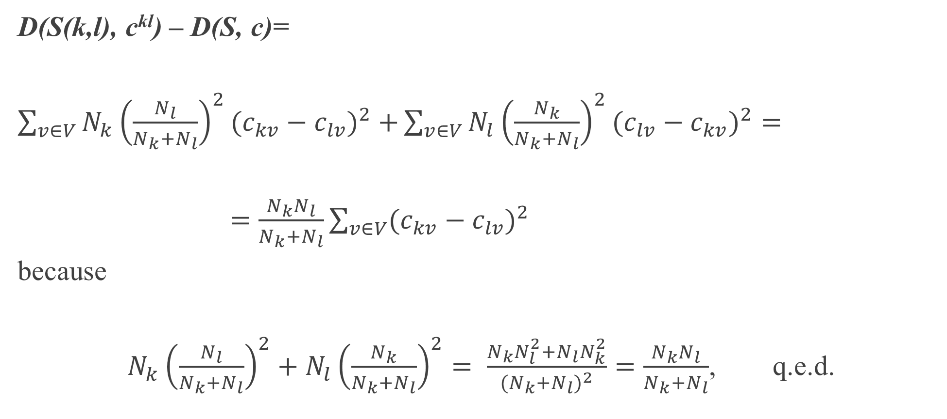
With a similar trick at S_{l,}
D(S(k,l), c^{kl}) – D(S, c)=
$\sum_{v∈V}{N_{k}{\left(\frac{N_{l}}{N_{k}+N_{l}}\right)}^{2}(c_{kv}−c_{lv})^{2}+}\sum_{v∈V}{N_{l}{\left(\frac{N_{k}}{N_{k}+N_{l}}\right)}^{2}(c_{lv}−c_{kv})^{2}=}$
$=\frac{N_{k}N_{l}}{N_{k}+N_{l}}\sum_{v∈V}{(c_{kv}−c_{lv})^{2}}$
because
$N_{k}{\left(\frac{N_{l}}{N_{k}+N_{l}}\right)}^{2}+N_{l}{\left(\frac{N_{k}}{N_{k}+N_{l}}\right)}^{2}= \frac{N_{k}N_{l}^{2}+N_{l}N_{k}^{2}}{{(N}_{k}+N_{l})^{2}}=\frac{N_{k}N_{l}}{N_{k}+N_{l}}$, q.e.d.

Slide 19
NN clustering relates to the graph-theoretic concept of Minimum Spanning Tree (MST), 1
Given a dissimilarity matrix, it can be represented by a weighted graph.
A tree is a subgraph with no cycles
A spanning tree is a tree whose node set coincides with the set of all objects
The length of a tree is the sum of weights of its edges
The minimum spanning tree is a spanning tree of minimum length.
If the data is a similarity matrix, we look for a maximum spanning tree.

Slide 20
NN clustering relates to the graph-theoretic concept of Minimum Spanning Tree (MST), 2
NN agglomerative clustering and NN divisive clustering over a (dis)similarity matrix
is equivalent to
agglomerative or divisive clustering
over its Min/Max spanning tree.

Slide 21
Prim’s algorithm for MST: Building MST T by adding nodes one-by-one (greedy)
1. Initialization.
Start with tree T consisting of an arbitrary node i∈I with no edges.
2. Tree update.
Find j∈ I-T maximizing a_{ij} over all i∈T and j∈I-T. Add j and edge {i,j} with the maximal a_{ij} to T.
3. Stop-condition.
If I-T=∅, halt and output tree T. Otherwise, go to 2.
Quest: What MST is built with this algorithm: Maximal or Minimal?

Slide 22
Example: Digits 0, 1, 2,…, 9 confusion data (symmetrized)
Stimulus | Response 1 2 3 4 5 6 7 8 9 0
1 2 3 4 5 6 7 8 9 0 | 877 11 18 86 9 20 165 6 15 11 11 782 38 13 31 31 9 29 18 11 18 38 681 6 31 4 31 29 132 11 86 13 6 732 9 11 26 13 44 6 9 31 31 9 669 88 7 13 104 11 20 31 4 11 88 633 2 113 11 31 165 9 31 26 7 2 667 6 13 16 6 29 29 13 13 113 6 577 75 122 15 18 132 44 104 11 13 75 550 32 11 11 11 6 11 31 16 122 32 818

Slide 23
Example: Digits 0, 1, 2,…, 9 confusion data as a graph (weights > 21)
6 0
88 31 113 122
31
5 2 29 8
38 29
31 75 32
104 3
31 132
9
7 26 44
4
165 1
86

Slide 24
Maximum ST to build
Start with arbitrary node. Let it be 0.
A. Find a node nearest to 0:
0 --- 8 (122) which is current T.
B. Find a node which is the nearest to either 0 or 8: 0---8(122)---6(113)
C. Find a node nearest to either 0 or 8 or 6: 0---8(122)---6(113)----5 (88)
D. Find a node nearest to 0, 8, 6, or 5:
0---8(122)---6(113)----5(88)----9(104)
E. Find a node which is the nearest to either of 0,8,6,5,9:
0--8(122)--6(113)--5(88)--9(104)--3 (132)
Quiz: Why Maximum ST?
6 0
88 31 113 122
31
5 2 29 8
38 29
31 75 32
104 3
31 132
9
7 26 44
4
165 1
86

Slide 25
Maximum ST built (see in red)
F. Find a node which is the nearest to either 0,8,6,5,9,3:
0---8(122)---6(113)----5(88)----9(104)----3 (132)
|
4 (44)
G. F. E. A node which is the nearest to either 0,8,6,5,9,3, 4:
0---8(122)---6(113)----5(88)----9(104)----3 (132)
|
4 (44)----1 (86)
2(38)
H. Final MST: |
0--8(122)--6(113)--5(88)--9(104)--3 (132)
|
4(44)--1 (86)–7 (165)
6 0
88 31 113 122
31
5 2 29 8
38 29
31 75 32
104 3
31 132
9
7 26 44
4
165 1
86

Slide 26
Convert an MST to a Nearest Neighbor Hierarchy/Partition
K-part partition: Cut K-1 weakest links
NN binary hierarchy: build a hierarchy top-down by cutting the weakest link at each step

Slide 27
NN Partition: at K=4, cut 3 weakest links
2(38)
|
0--8(122)--6(113)--5(88)--9(104)--3 (132)
|
4(44)--1 (86)–7 (165)

Slide 28
NN Hierarchy Divisively: Sort MST links, cut over the weakest link one by one
All 2(38)
All without “2” cut38
cut44
0--8--6--5--9--3 4--1–7
cut88 cut86
0--8—6 5—9--3 4 1—7
cut113 cut104
0—8 6 5 9—3 1 7
0 8 9 3

Slide 29
NN Hierarchy with a height function, say h(t)=170-cut(t)
All h axis
All without “2” cut38 2(38) 132
cut44
0--8--6--5--9--3 4--1–7 126
cut88 cut86
0--8—6 5—9--3 1—7
cut113 cut104
0—8 9—3
0 8 6 5 9 3 4 1 7 0

Slide 30
Основные понятия
Кластерная иерархия
Высотная функция\Height Function
Агломеративный кластер-анализ
Дивизивный кластер-анализ
Расстояние между кластерами:
Расстояние Уарда (Ward)
Расстояние ближнего соседа (Nearest Neighbor)
Расстояние Уарда как прирост критерия К-средних при объединении кластеров
Минимальный/Максимальный остов (Max/Min Spanning Tree)
Алгоритм Прима (Prim’s)
Дивизивный метод ближнего соседа на основе MST

